Slide 1
First Steps in Web Design

Slide 2
introduction
Originally designed in the 1960s
as a way for scientists to communicate their research
Exponential growth of web sites since 1992
the Web has become increasingly commercialised and entertainment focused.
Notes:
You will often find that the terms Web or Internet are used interchangeably and that people really mean the same thing: the Web or Internet being what is used to find information remotely on other computers.

Slide 3
mapping it all out
servers
www or intranet
info found
3. information sent
to browser
2. browser requests
information
browser (Internet Explorer)
1. request made
to browser
4. Browser displays
information
client

Slide 4
terms
Web pages are written in a language called HTML (HyperText Markup Language)
The website address is often referred to as an URL (Uniform Resource Locator)
Frontpage is a web design program that codes the pages (into html) as you create them.
Notes:
The acronym "URL" stands for Uniform Resource Locator. The acronym "http" stands for Hypertext Transfer Protocol. You don't need to remember either of these definitions to function in today's information society. Rather, try to remember that a URL is a World Wide Web address and that most World Wide Web addresses begin with "http".

Slide 5
web design – the first steps
2 questions
1. what is the purpose of the site? (AIMS)
2. who is the site for (audience)
Consider including a one sentence tagline on the homepage
Notes:
Who is the intended audience
What is the larger goal?

Slide 6
purpose
This site is meant to be informative.
The site will be used to sell a product.
The site will be used to recruit new members to our organization.
The main purpose of the site is educational.
The primary purpose of the site is to be a newsletter.
I wanna spread some gossip.
Notes:
Identify the Purpose of the Site
A Web site may have several purposes. In that case it is necessary to determine which is the primary purpose, which is secondary, and so on. A site that is intended to be strictly informative, such as a news site, is likely to look much different that a site that is designed to sell a product. On the other hand, a site for a college may have some subtle similarities to a site that sells books. The college site probably will be intended to present the school is a very positive and manner so that students will want to enroll. The retail book site will want to convince visitors that it is the best place to purchase reading material.

Slide 7
who?
Students at a university.
People between the ages of 18 and 24.
Expert Internet users.
Patients
Internet newbies.
My mom
My clever cat
Notes:
Identifying Who will Visit the Site Determining who the visitors are likely to be is crucial in deciding not only the general appearance of the site, but also the technology that might be used to build the site.
If the project is likely to have visitors who log in from home, it is necessary to design the pages with the understanding that users will probably have slow modem connections.
On the other hand, if visitors are expected to be fans of a rock band, then high-end technology such as Flash may be acceptable.

Slide 8
LET’S PLAY
Microsoft Frontpage
Build a site map – good old pen and paper
Develop a web page template
Title each page
Determine and add content
Link pages together and build a navigation structure
Notes:
Web page template = to give your site a “look and feel”
Now organize your content into logical and independent categories. Try to limit your content categories to
between five and six topics.
Make sure that your website has a clear "title" that tells the user what its larger goal and purpose is.
Make sure that each webpage in your site has a clear title as well
Make sure that each webpage has a clear "visual hierarchy" that makes it easy for the user to
determine what are its central elements.

Slide 9
site map
The basic unit of any website is a web page
The main web page from which everything stems is called the homepage (often identified by file name index.htm or default.htm)
motorbikes
product news
gallery
technical info
vintage
sports
members’
files
Notes:
Index.htm, similar to the index case which people refer to in contact tracing

Slide 10
welcome back
a bit more theory to finish off with

Slide 11
Good web design
CONTRAST
REPITITION
ALIGNMENT
PROXIMITY
NAVIGATION
e
TEXT PRESENTATION & FONTS
disobey these rules and you
will get a CRAP NeT

Slide 12
CONTRAST
this is an example of poor contrast
universal warning sign
another example of how contrast provides a warning
contrast to make something stand out
white on black is harder to read than black on white
Use active white space to make your content
stand out on the page.
Notes:
Poor contrast = colour of text is not different enough from the background colour
Alternating black and yellow strips are a universal warning signal that indicate danger nearby. It is important to note that they are also the decoration of the honey bee. The bee uses them to warn predators that they sting!
Contrast works in several different ways. Perhaps the most obvious example of contrast is the colour of text against a background. It is much easier to read text that contrasts highly with the background. However, contrast can also include all sorts of differences between elements. Under some circumstances, contrast is used to make something different so that it stands out. This helps to indicate what is important.
Higher contrast is far easier to read. This text is much easier to read than the text above. But tests indicate that white wording on a black background is harder to read than the black text on a white background that is to the left.
However, contrast can also include all sorts of differences between elements. Under some circumstances, contrast is used to make something different so that it stands out. This helps to indicate what is important.

Slide 13
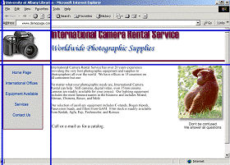
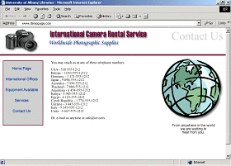
REPITITION
Notes:
Repetition is not only saying the same thing several times to get a point across. It is also the use of a consistent theme throughout a web site. While all the pages on a web site do not have to be exactly the same, there should be enough similarities to create a consistent look and feel to the site. This consistency is one of the things that help make a site easy to navigate. But, the basic design elements repeat, thus giving the page a familiar appearance and feel.

Slide 14
ALIGNMENT
Centre alignment makes finding the beginning of a new line of text much more difficult.
Each line tends to be a different length. As a result it is much more tiring to read text with centre alignment. The eye is constantly guessing and searching for the start point.
In addition, centre alignment causes odd line lengths. These odd lengths cause a sort of "choppiness" in how the text reads. It lacks the smooth flow that tends to occur with left alignment.
Notes:
One of the most critical principles of design is alignment. Like proximity, alignment can enhance or detract from the appearance of a Web page. But in addition, it can significantly affect the readability of material on a page. The alignment style for an entire page, not just the text, must be selected. Proper alignment will create strong associations and a pleasing presentation.

Slide 15
PROXIMITY
Notes:
Proximity refers to the distance between elements on a web page and how the elements relate to one another. These elements include text, navigation, headings, and so on.
Generally speaking, elements that are close together appear to have a stronger relationship than elements that farther apart.
The illustrations at the right demonstrate the difference that proximity makes. The wide spacing of the weak layout is caused by the dots being placed far part.
The first image creates a more robust image and more powerful feeling because of the closer spacing. In the weak layout the squares do not look related. However, in the strong layout there is a greater sense of the squares being related because the are closer together

Slide 16
NAVIGATION
There are several basic styles of navigation
[HORIZONTAL] [HORIZONTAL] [HORIZONTAL] [HORIZONTAL]
TOP
VERTICAL
VERTICAL
VERTICAL
VERTICAL
VERTIVAL
VERTICAL
VERTICAL
VERTICAL
not
recommended
use the
three click rule
LEFT
RIGHT
BOTTOM
Notes:
Top and side navigation are the most common. Right side navigation is extremely rare. Because it is so rare, it should generally be avoided because Web visitors are not used to it.
Bottom navigation is used when pages are long. This eliminates the need for the page visitor having to scroll back to the top of a page to access a link.
Often navigation links are created using an effect called a "rollover." This effect often appears as a link changing shape or colour.
On complicated sites navigation can be divided into primary and secondary categories. If we set the top navigation as primary, it should remain identical from page to page. If we set the side navigation as secondary, each group of sub pages under the various primary navigation categories has its own custom navigation on the side.
Make sure your website navigation follows the "three-click rule," allowing users to find what they are looking for on your site in three clicks or less.

Slide 17
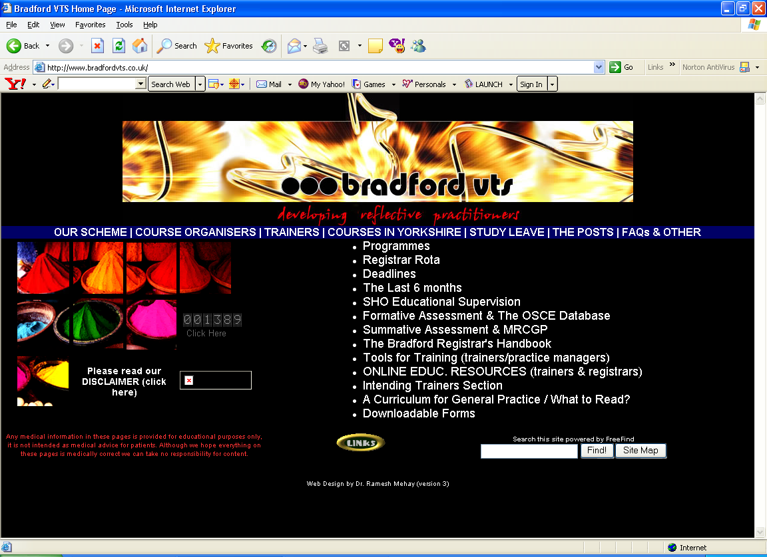
primary
secondary
Notes:
Putting all the possible links, both primary and secondary, on one page would make the page far too complicated and nearly impossible to use.

Slide 18
FONTS
Arial
Times New Roman
Courier
Batang
Monotype Corsiva
Haettenschweiler
Notes:
It is important to remember that the Web is primarily a visual medium. Despite the proliferation of sound and moving images, text remains the primary way that information is presented.
Text in Web pages is displayed by browsers using the fonts available in the viewer's computer. Most PC users have Arial and Times New Roman installed. Macintosh computers usually have Helvetica and Times. Arial is similar to Helvetica and Times is similar to Times New Roman. The vast majority of text presented on Web pages is limited to these fonts for both practical and technical reasons.

Slide 19
TEXT PRESENTATION
Large text is hard to read because people can only read one or two words at a time.
Small text is difficult to read because many computer screens cannot clearly display the tiny characthers. Also, small print is hard to see under the best of circumstances.
Text size ranges from 1 to 7. 1 is the smallest, 7 the largest. Default is 3.
HTML also allow setting relative sizes. Included are +1 through +7 and -1 through -7. These sizes are not specific, but, are relative to the browser default size.
Notes:
The default text size for a Web page is "3." It can be specified within the HTML of a Web page. If it is not, the browser automatically displays the font at size 3 unless the user has changed the settings. As with fonts, it is usually necessary to specify the size of the text so that the browser settings do not over ride the designer's intentions.
Text size ranges from 1 to 7. 1 is the smallest, 7 the largest. HTML also allow setting relative sizes. Included are +1 through +7 and -1 through -7. These sizes are not specific, but, are relative to the browser default size.

Slide 20
how to make horrible websites
Add turn-off colours or bad contrast
Using silly fonts at silly sizes
Add tonnes of pictures (slows site down)
Add loads of flashing images (jpegs, gifs,bmps)
Tonnes of pages (three hundred clicks to get anywhere)
Background music
Notes:
Pictures: slow the site down
Flashing images can be annoying and distracting
Too many pages without a good navigation structure just means the visitor gets lost and never comes back again once (s)he has found a way out
Background music takes too long to download, many people cannot hear it, and it will probably sound bad

Slide 21
top tips
Use the KISS principle (Keep It Simple, Stupid)
(beware of too much text on a webpage, plenty of white space too)
Develop a common "look and feel" for the entire web site.
Make sure every web page has a clear focal point
Make sure that your webpages use names that indicate what their content is.
Always test your website and webpages
Revisit your aims and objectives – have they been met?
Get other people to look at and explore your website and get feedback from them
Beware of exhaustive lists of links – they’ll never get visited. Keep It Simple – few important ones
Notes:
Design using the "Kiss Principle" (Keep it simple, Stupid).
Don't throw too much content onto a webpage or put too many fancy web multimedia goodies on your pages
Make sure every webpage has a clear "focal point“ that draws the user into the page. Beware of clutter
and multiple "focal points."
Make sure that your webpages use names that indicate what their content is. If you can, use some of the keywords
for your website as filenames; this makes it easier for Search Engines to list them.
Always test your website and webpages out on multiple computer platforms--Mac and PC--running at variable
speeds between 56 kps to 100 Mps.
Make sure you have other people look at and explore your website and get feedback from them about how
it works. Good user feedback is essential for successful, dynamic websites.
Develop a common "look and feel" for the entire web site. Good design is always consistent and predictable.
Beware of putting too much text on a web page.
Make sure there is plenty of white space to make your content stand out.

Slide 22
If you plan to put it on the web
Make sure you use a sensible domain
www.bradfordvts.co.uk = good
www.hotmail.com/sp1/malcolminthemiddle.htm = bad

Slide 23
final thought
The Web is a great source for information but remember it is not the only source.
A tremendous amount of information is only published in paper format such books, reports, newspapers, magazines and academic serials.
Over 100,000 different book titles and 20,000 magazine and other serial titles are published every year all over the world!

Slide 24
Sources
http://www.colorado.edu/AmStudies/lewis/Design/sofar.htm#basic
http://library.albany.edu/imc/webdesign/index.htm
http://build-website.com/guide/index.html = good basic guide
http://www.plainenglish.co.uk/webdesign.html
http://www.microsoft.com/Education/FrontPageTutorial.aspx click on Frontpage 2002 Creating a course web for some good Frontpage advice

